Slide 1
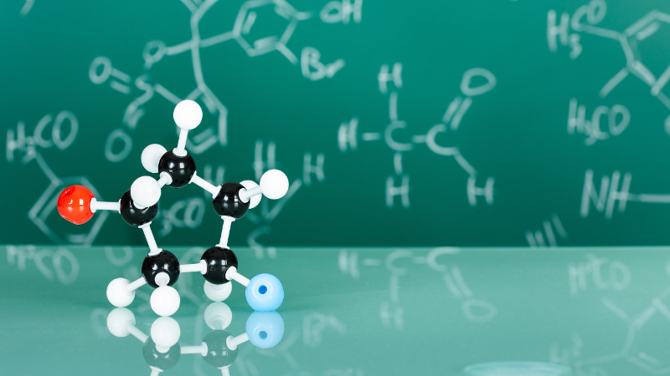
Functional Groups

Slide 2
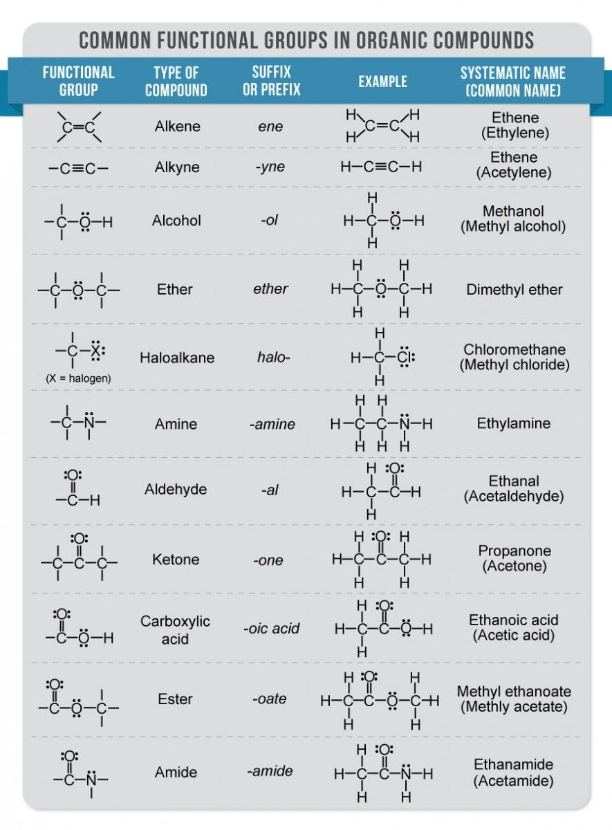
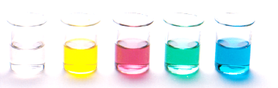
Functional Groups
Simple hydrocarbons only contain carbon and hydrogen
Organic compounds can have functional groups including the elements O, N, P, S, F, Cl, Br and I
These elements have a significant impact on the physical and chemical properties of the molecules
*organic chemistry doesn’t include CO₂, CO and carbonates

Slide 3
Functional Groups
Experiment 29: Functional groups and isomers
We will be making models of compounds with different functional groups
To understand the properties of these molecules you should consider the bonding involved, their shape in relation to the functional group, and the possibility of isomers
The purpose of the experiment – introduce the different functional groups we will be studying and to provide you with a mental picture of each type of molecule when we move through the theory.

Slide 4
Functional Groups
A functional group determines all the following properties of a molecule:
Bonding and shape
Type and strength of intermolecular forces
Physical properties
Nomenclature
Chemical reactivity

Slide 5
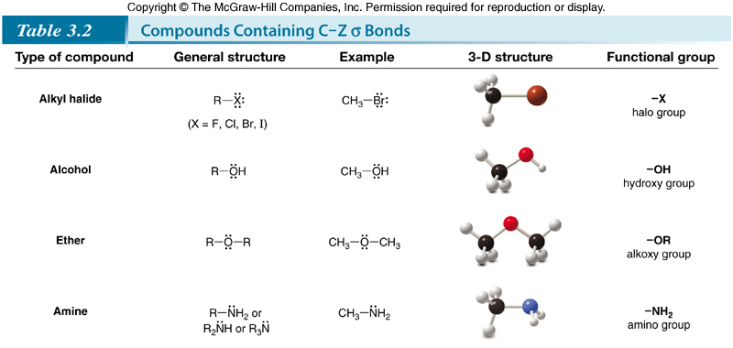
Functional Groups

Slide 6
